Slide 1
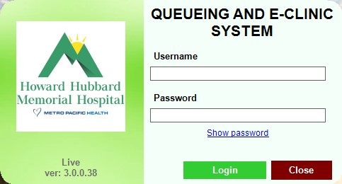
QUEUING MANAGEMENT SYSTEM

Slide 2
SELF QUEUING KIOSK
ANNUAL PHYSICAL EXAMINATION (APE)

Slide 3
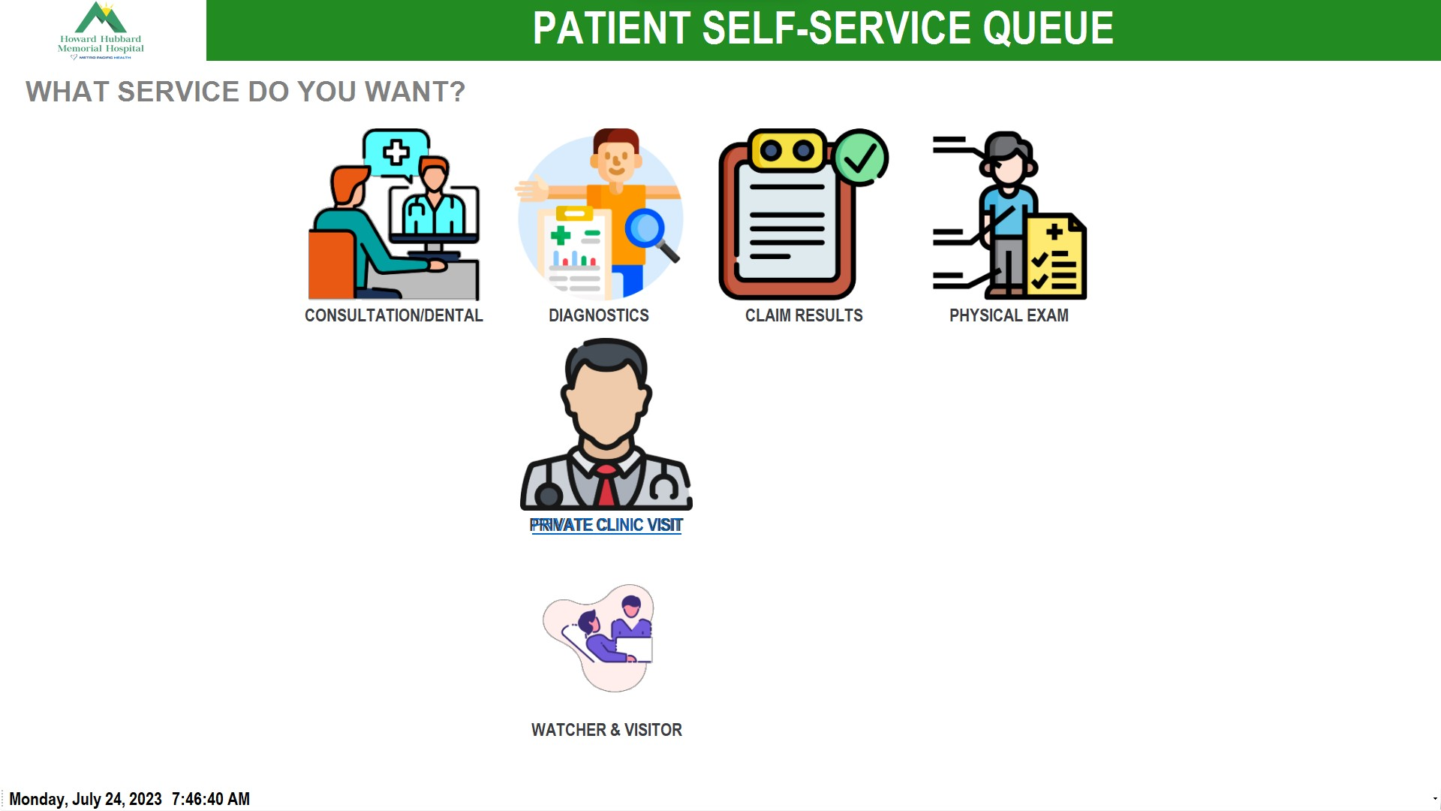
PATIENT WILL CHOOSE TRANSACTION

Slide 4
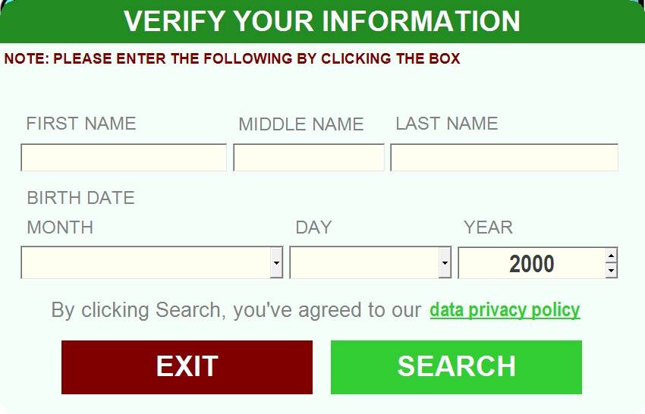
PATIENT WILL ENCODE DETAILS
THE CLICK SEARCH

Slide 5
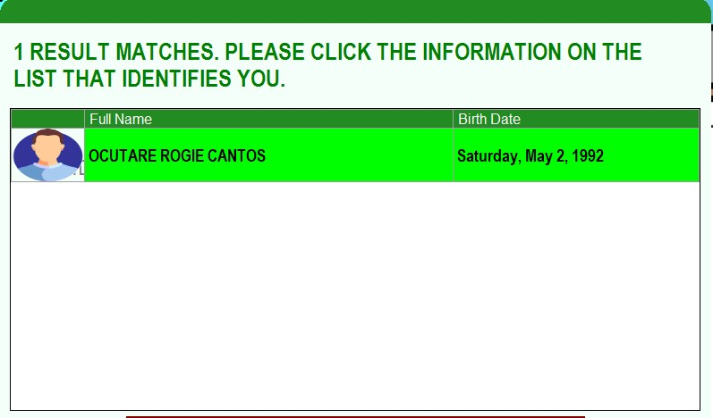
DOUBLE CLICK THE NAME

Slide 6
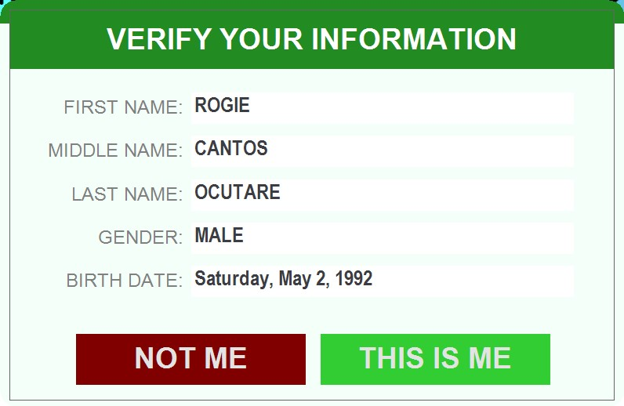
CONFIRMING IF THE DATA IS CORRECT

Slide 7
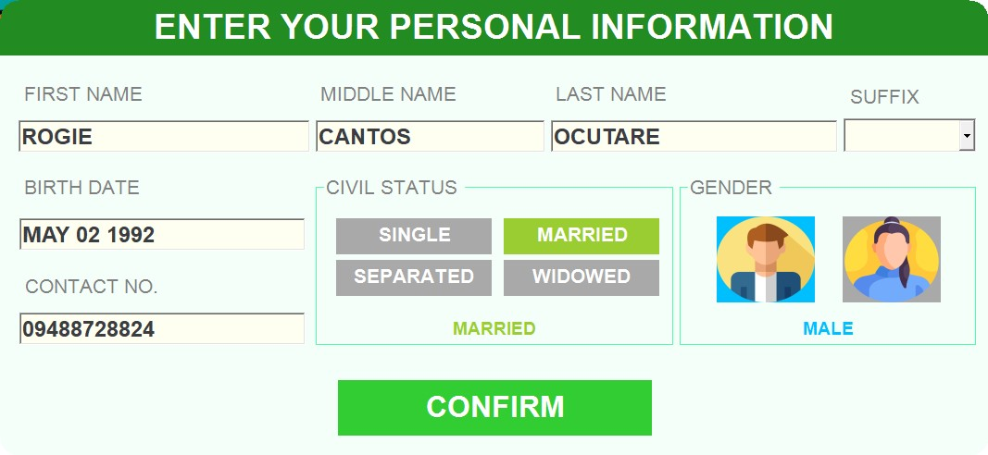
IF PATIENT’S DATA HAS CORRECTION THEY CAN EDIT IT THEN CLICK CONFIRM

Slide 8
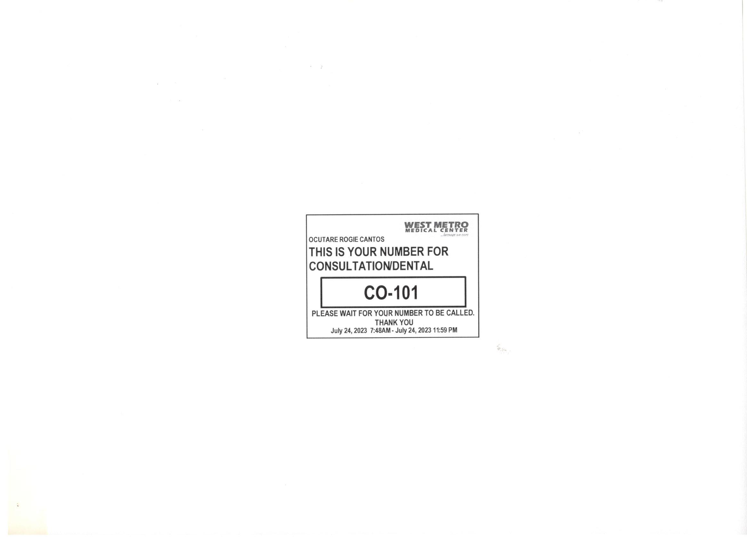
A PRINTED NUMBER WILL BE GENERATED

Slide 9
OPD STAFF WILL TAKE THE VITAL SIGNS OF THE PATIENT AND VISION TEST

Slide 10
REGISTRATION AREA

Slide 11
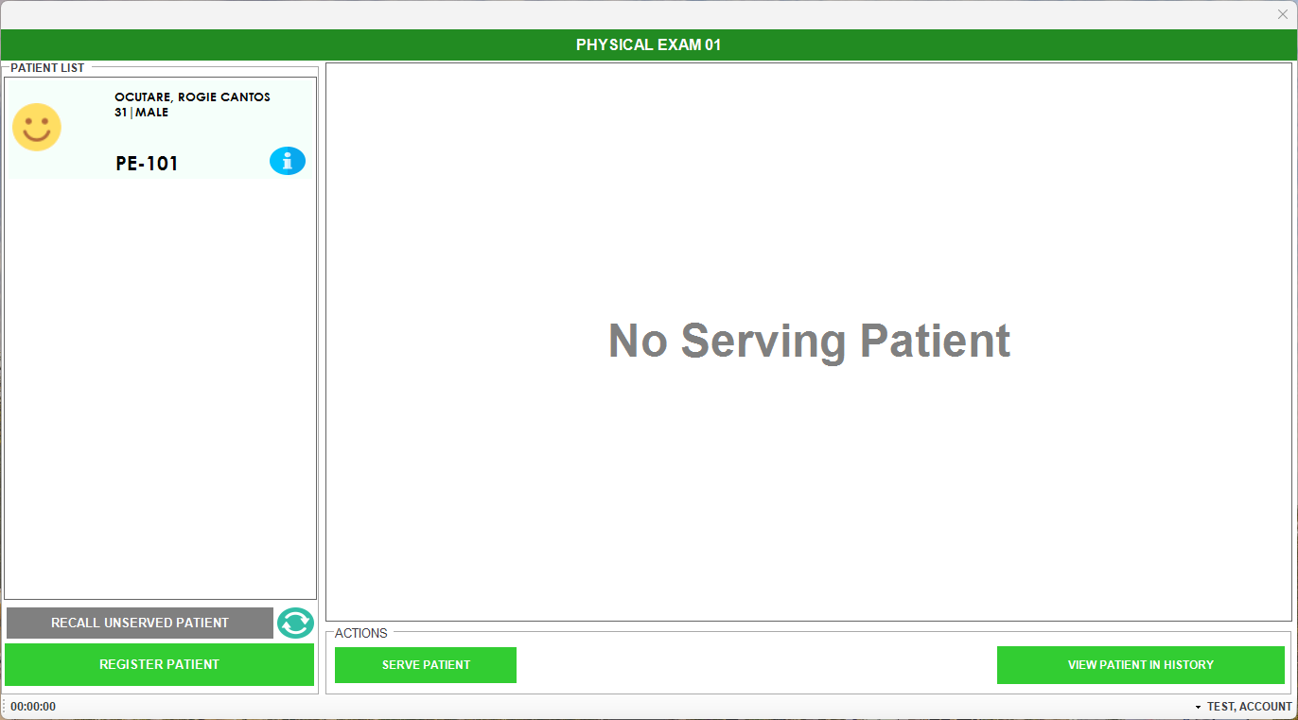
ENCODER WILL SERVE THE PATIENT
Note: There will be a tune to hear and Queue number will appear on the TV

Slide 12
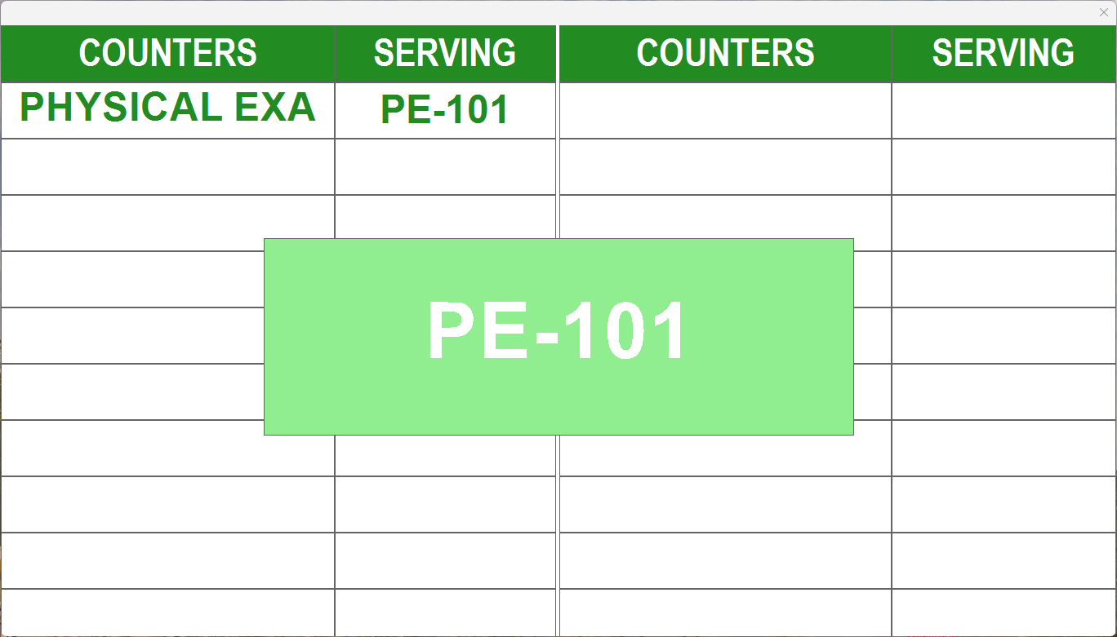
Note: There will be a tune to hear and Queue number will appear on the TV

Slide 13
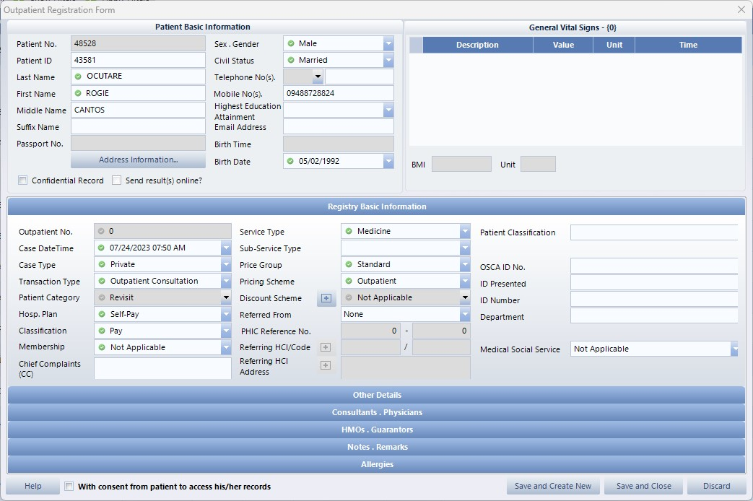
ENCODER WILL ENCODE PATIENT TO HIS

Slide 14
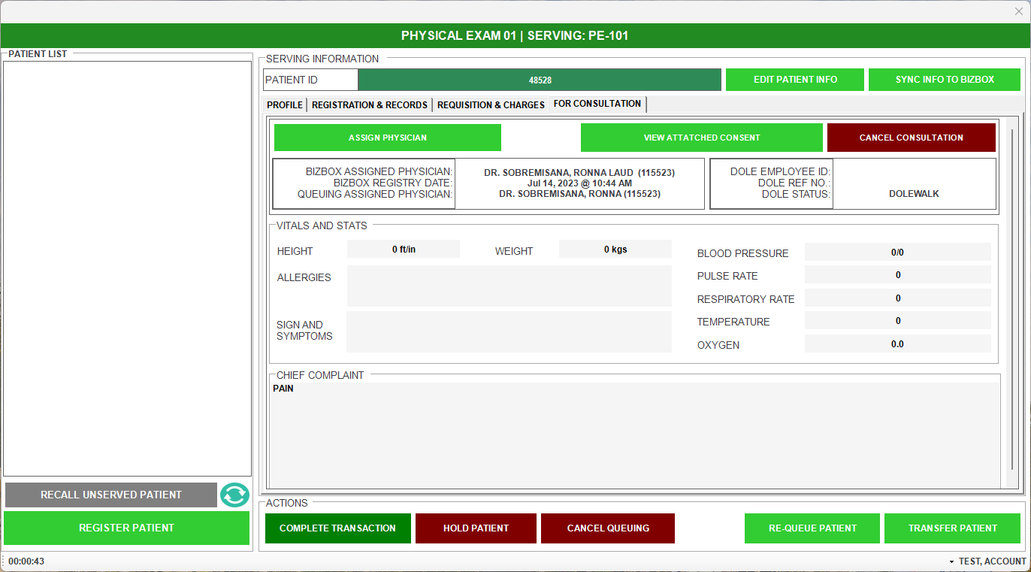
ENCODER WILL CLICK REGISTRATION & RECORDS

Slide 15
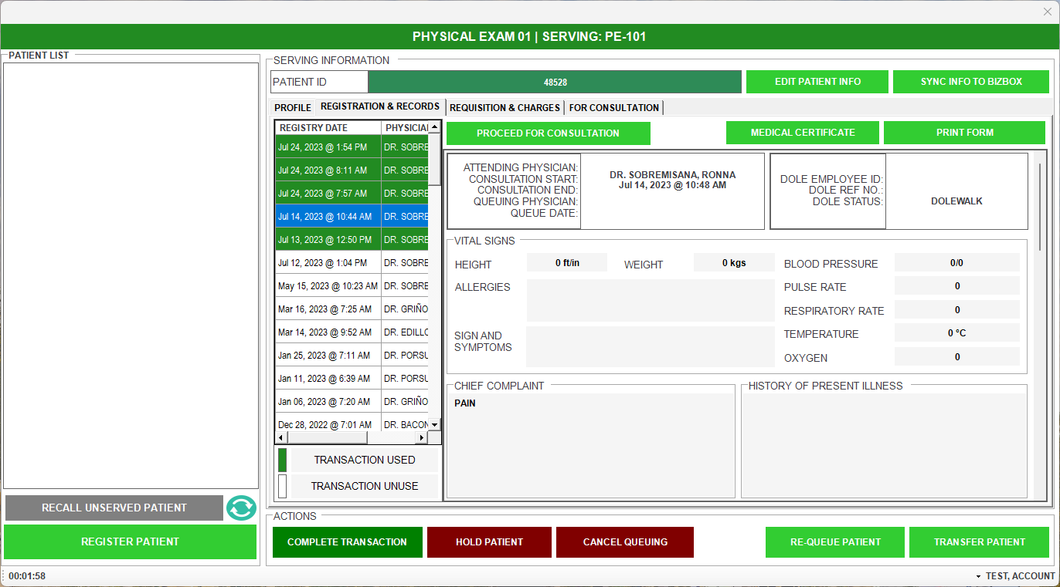
ENCODER WILL CLICK PROCEED FOR CONSULTATION

Slide 16
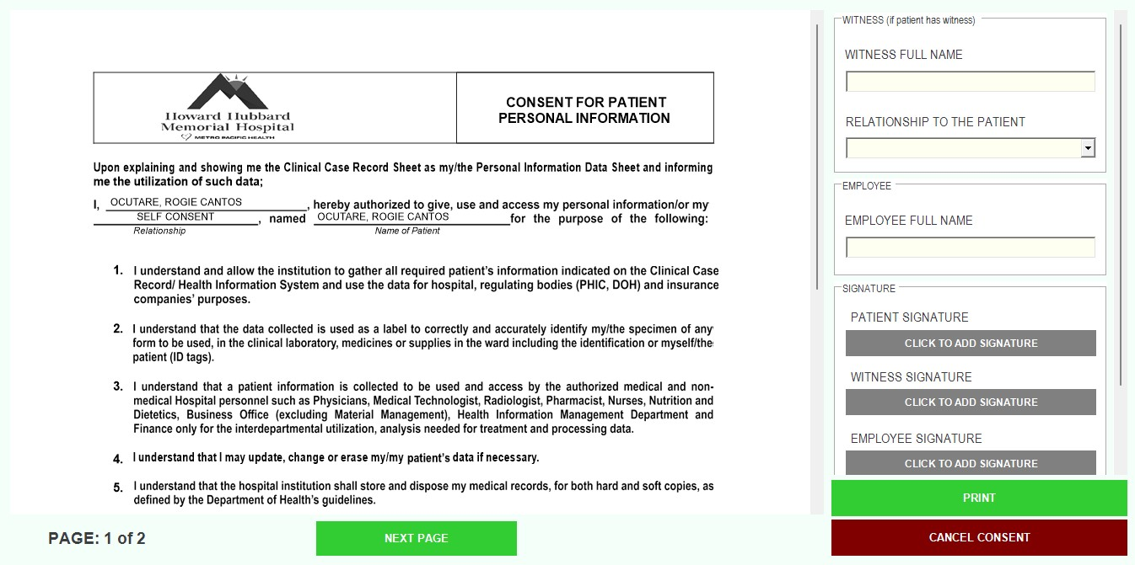
ENCODER WILL ASK THE PATIENT FOR CONSENT SIGNATURE AND CLICK ADD SIGNATURE

Slide 17
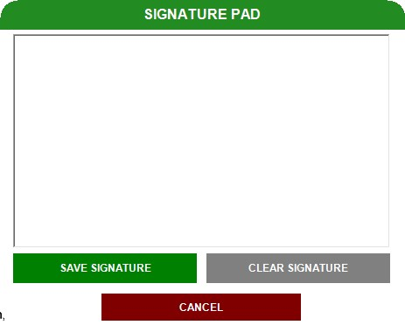
THE PATIENT WILL SIGN ON THE SIGNATURE PAD

Slide 18
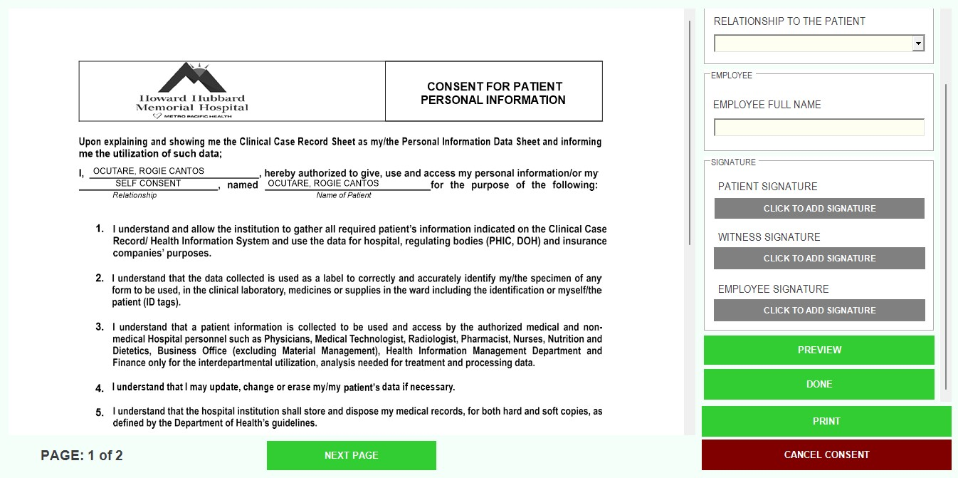
AFTER THE SIGNATURE IS ATTACHED ENCODER WILL CLICK DONE

Slide 19
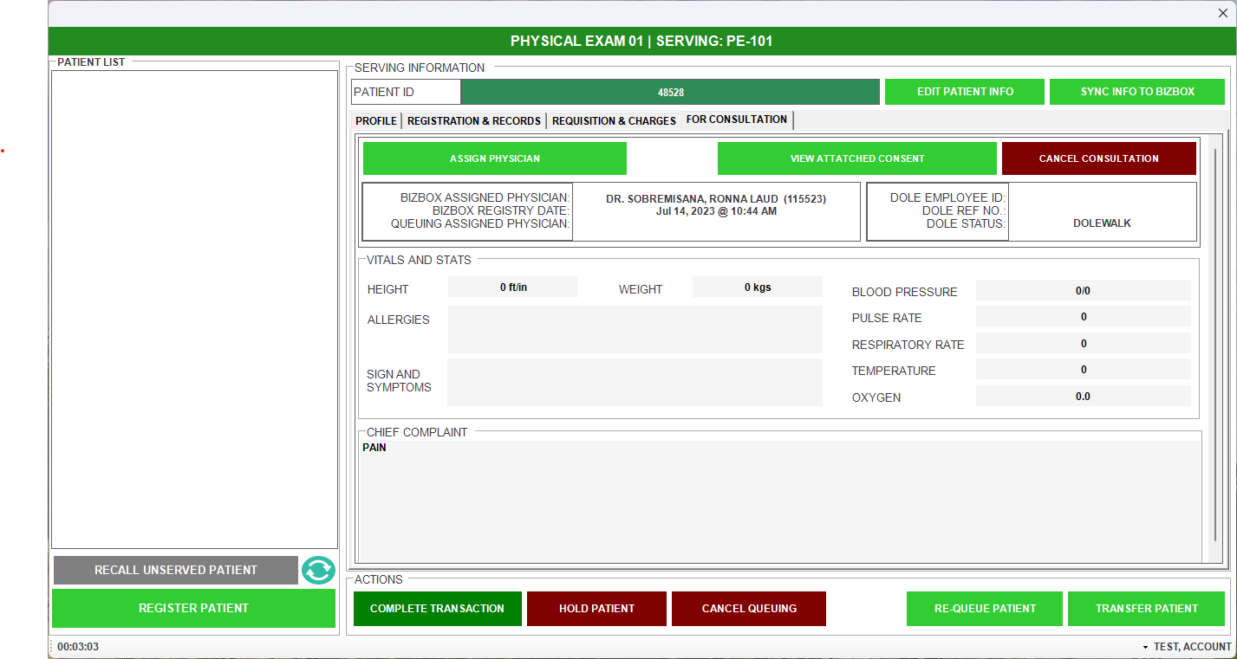
ENCODER THEN WILL ASSIGN QUEUEING ASSIGNED PHYSICIAN

Slide 20
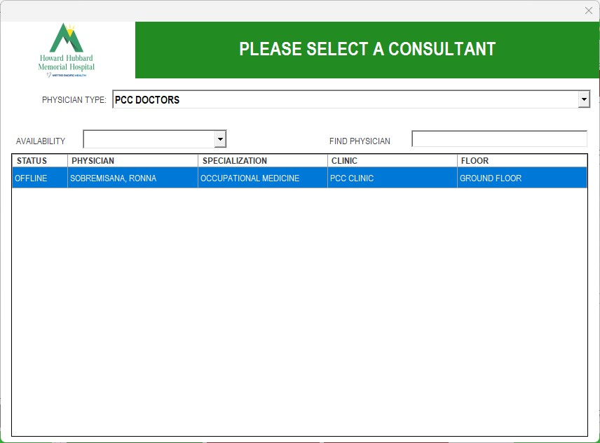
ENCODER THEN WILL SELECT THE PHYSICIAN

Slide 21
ENCODER THEN WILL TRANSFER PATIENT TO THE PHYSICIAN CLINIC

Slide 22
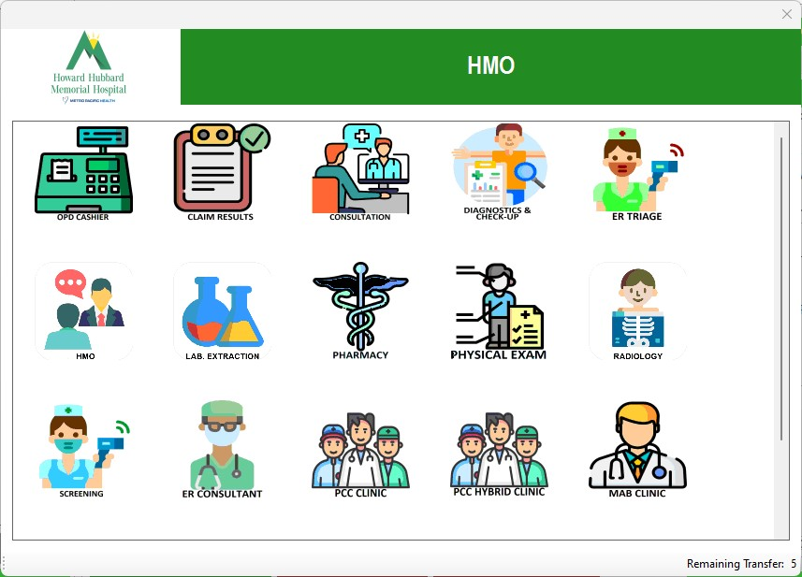

Slide 23
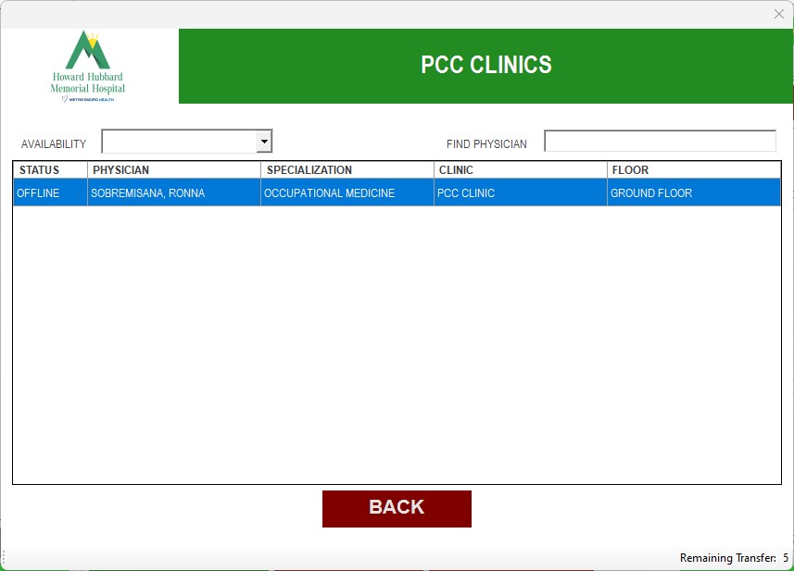
THEN SELECT THE NAME OF THE DENTAL DOCTOR, THEN ADD THE QUEUE TO MEDICAL DOCTOR
SAMPLE DOCTOR ONLY

Slide 24
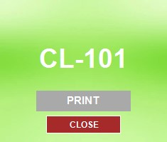
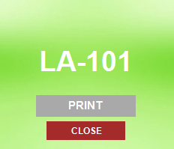
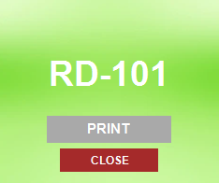
QMS THEN WILL GENERATE PRINTED TICKET
1 FOR PE DOCTOR
1 FOR DENTIST
DL - WILL BE THE CODE
FOR LABORATORY
FOR RADIOLOGY
FOR REVISION BY JASCHA

Slide 25
PATIENT THEN WILL GO TO OPD LABORATORY EXTRACTION AREA FOR BLOOD EXTRACTION AND PASS URINE & STOOL

Slide 26
THE OPD STAFF (RE-QUEUE) THEN WILL COMPLETE TRANSACTION IN LABORATORY.

Slide 27
DENTAL DOCTORS MODULE

Slide 28
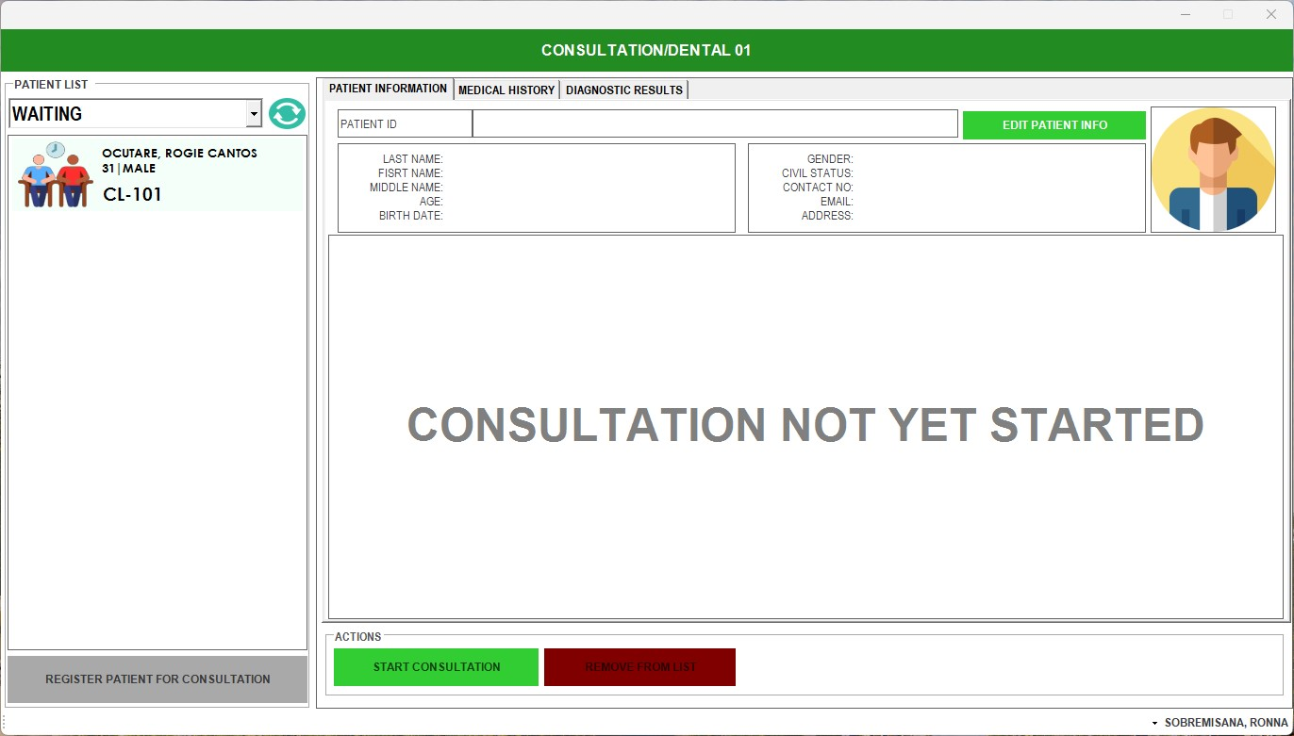
DOCTOR WILL SEE IF THERE ARE PATIENTS WAITING, THEN SERVE IF READY. THEY WILL CLICK THE NAME WITH THE LATEST NUMBER THEN CLICK START CONSULTATION

Slide 29
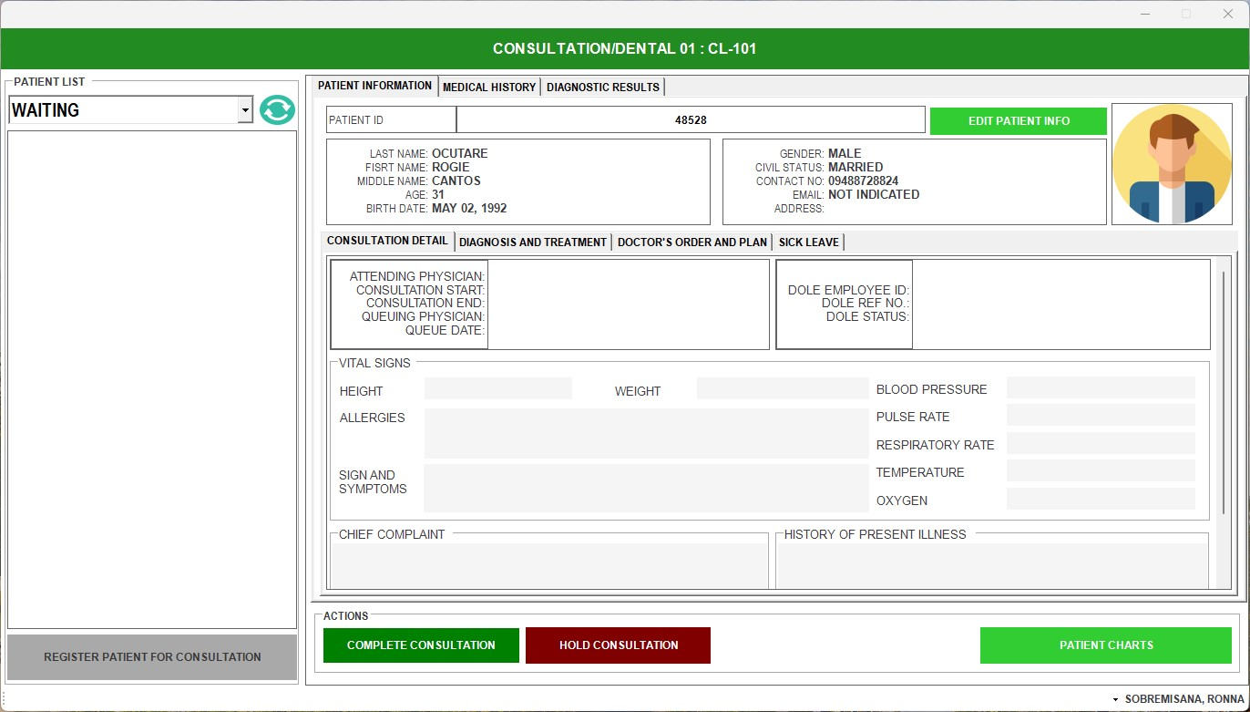
AFTER SERVING THIS WOULD BE THE APPEARANCE, THEN THE PATIENT WILL GIVE THE PRINTED NUMBER TO THE DOCTOR

Slide 30
THE DOCTOR WILL OPEN HOSPITAL INFORMATION SYSTEM (HIS)

Slide 31
THEN THE DOCTOR WILL INPUT ALL DENTAL RECORDS OF THE PATIENT

Slide 32
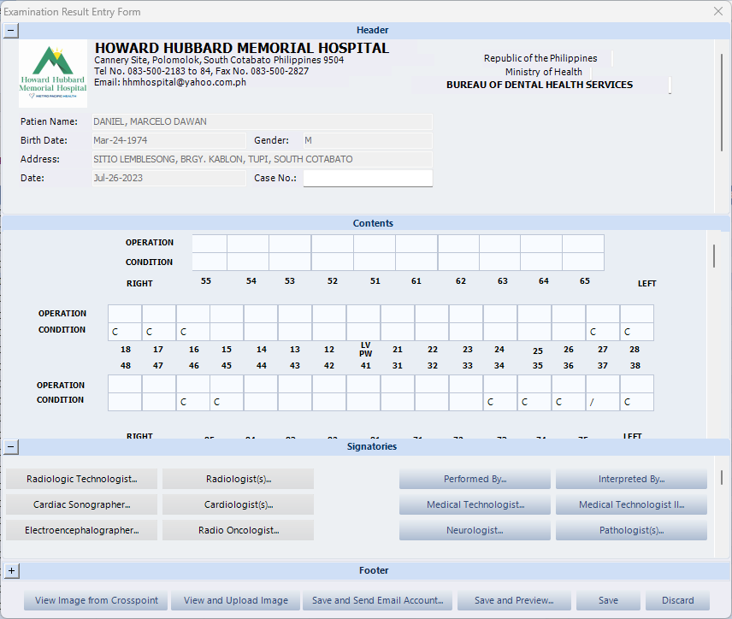
THEN THE DOCTOR WILL INPUT ALL DENTAL RECORDS OF THE PATIENT

Slide 33
CLICK SAVE, THEN OPEN EMR OPEN S.O.A.P AND CLICK SAVE AND CLOSE

Slide 34
P.E. DOCTORS MODULE

Slide 35
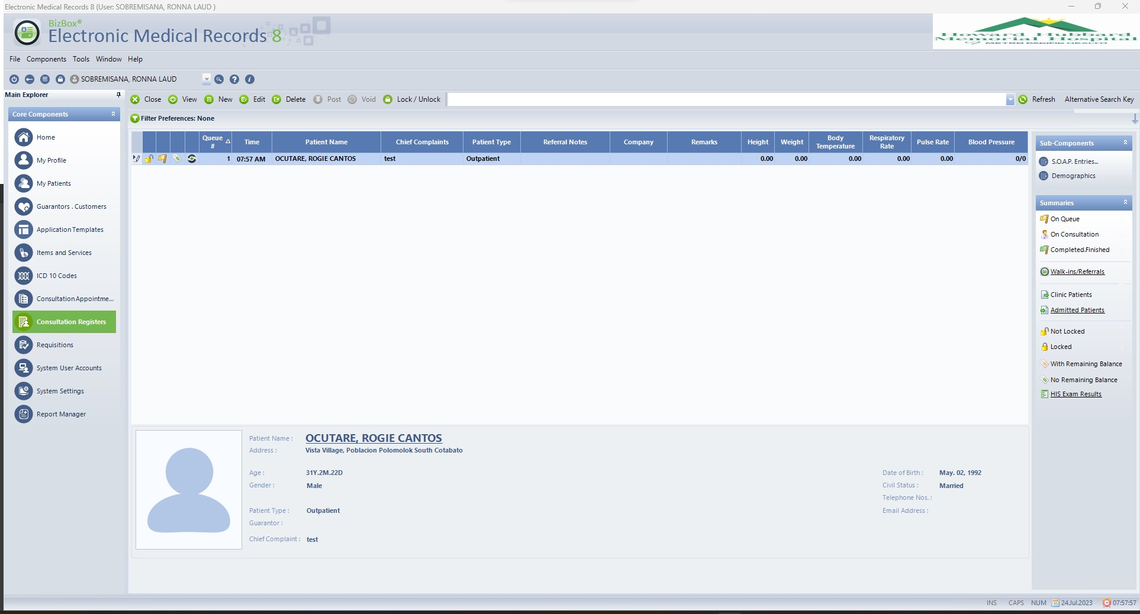
CLICK PATIENTS NAME THE CLICK S.O.A.P. ENTRIES

Slide 36
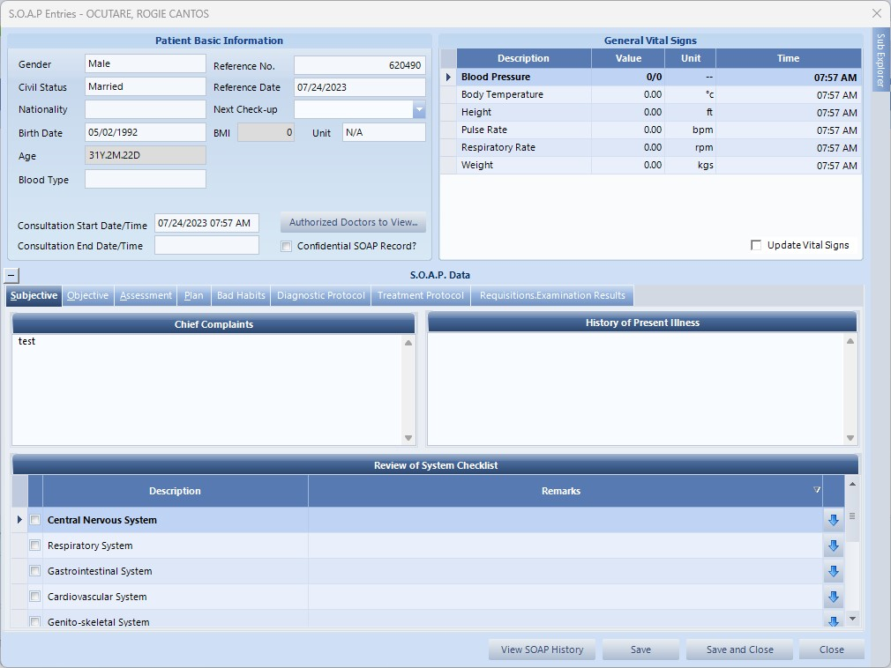
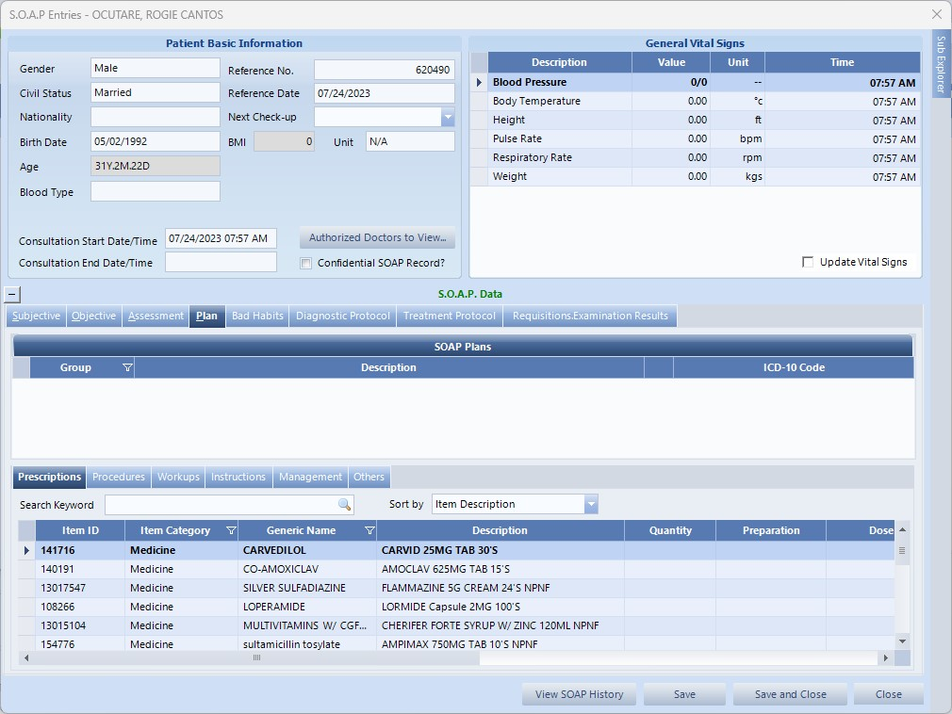
THEN THE DOCTOR WILL INPUT THE S.O.A.P. ENTRIES

Slide 37
CLICK SAVE AND CLOSE

Slide 38
PATIENT WILL NOW GO RADIOLOGY DEPARTMENT TO HAVE THE XRAY.

Slide 39
THE PATIENT THEN WILL GO TO OPD RE-QUEUE TABLE TO MANUALLY RE-QUEUE THE PATIENT TO PAP-SMEAR, ECG AND HEARING TEST.

Slide 40
IF THE PATIENT HAS DONE ALL TEST HE/SHE WILL PROCEED TO THE INFORMATION AREA TO SUBMIT THE APE CARDS.

Slide 41
END CONSULTATION

